Slide 1

Lemon Tree Monitoring System
Kamil pawlowski

Slide 2
Project Diagram

Slide 3
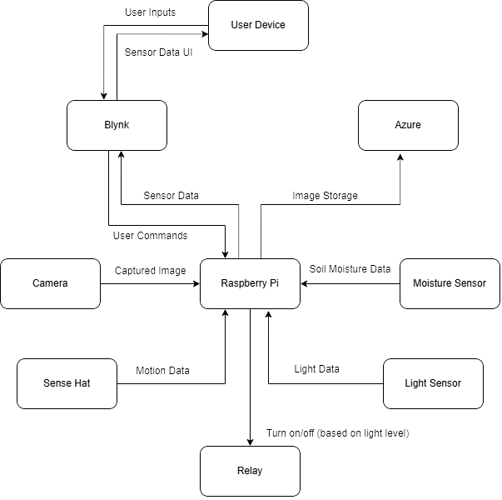

Slide 4
Algorithm Diagram

Slide 5
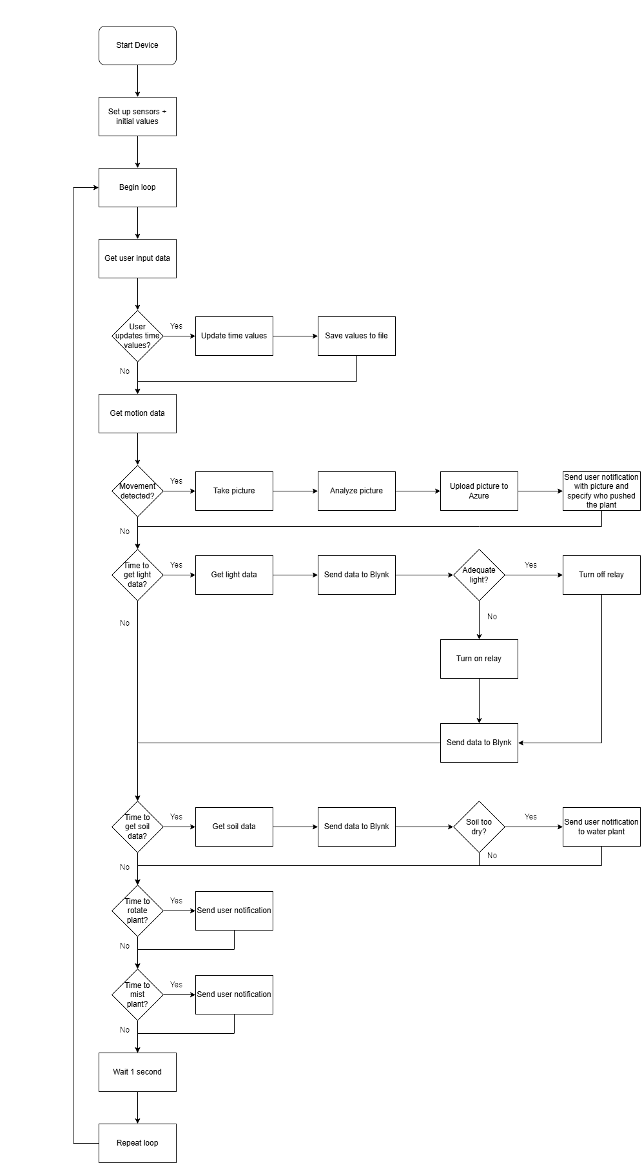

Slide 6
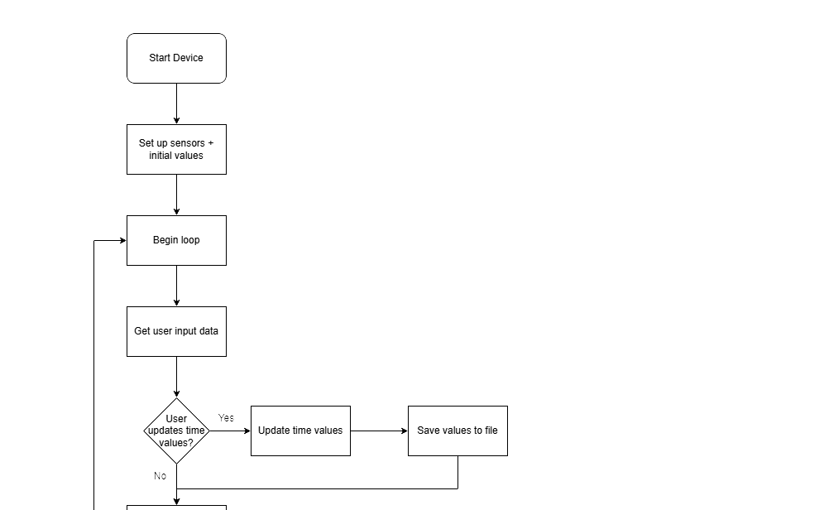

Slide 7
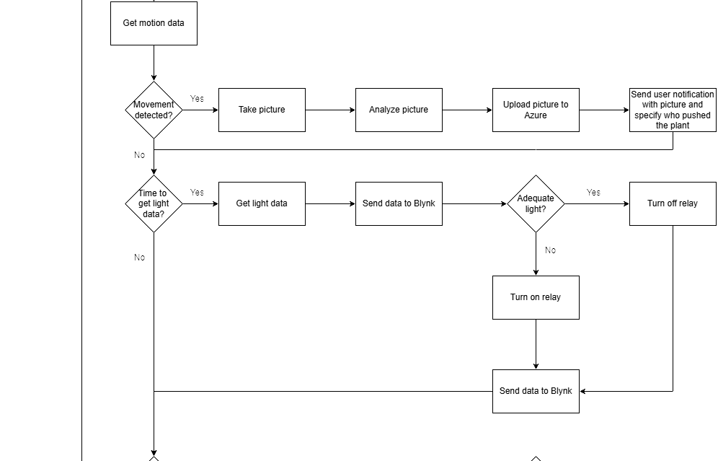

Slide 8
